Slide 1

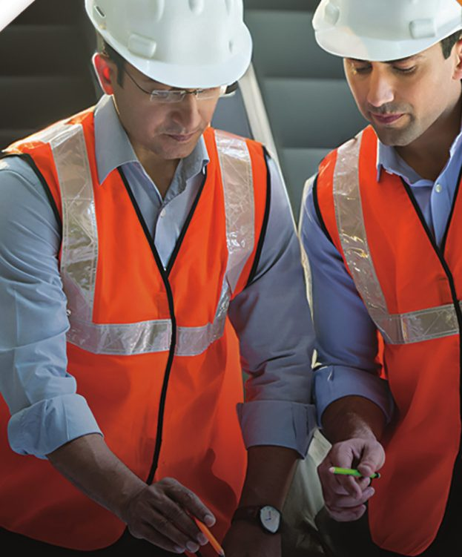
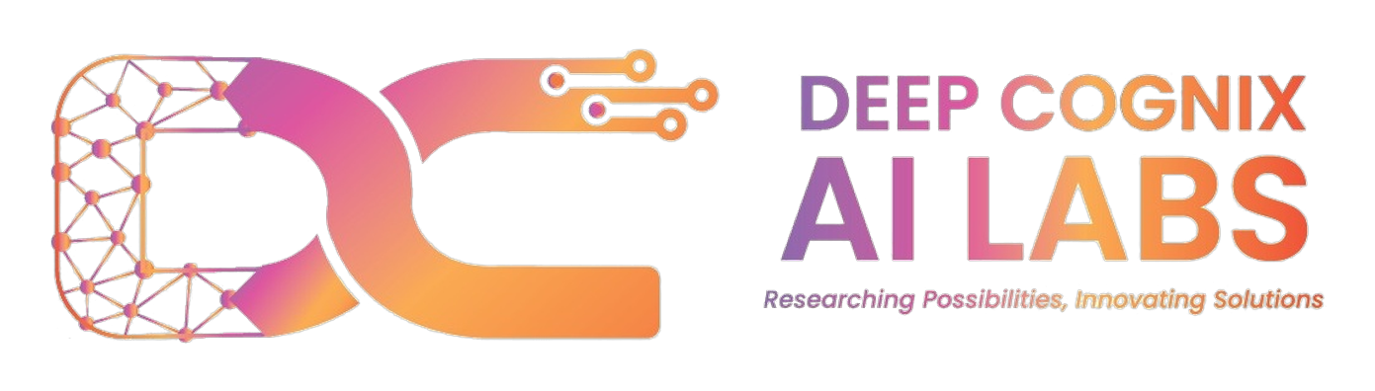

30-DAY VERTICAL TRANSPORTATION TRAINING
100% JOB
GUARANTEED TRAINING
For ITI, Diploma and Degree holders — Mechanical, Electrical, Electronics and allied trades. One month of training in Bengaluru, then deployment with a vertical transportation company.
30 DAYS
BENGALURU
PAN INDIA
Full-time training
Training location
Tier 1 & Tier 2 placement
Skill India certified
Certificate recognised under the Government of India's Skill India initiative
Limited seats · Enrol now: +91 99866 97969 | +91 97395 85515
1st Floor, T-4/A, 2nd Cross Road, Peenya 1st Stage, Peenya II Phase, Peenya, Bengaluru, Karnataka 560058
info@deepcognix.com

Slide 2

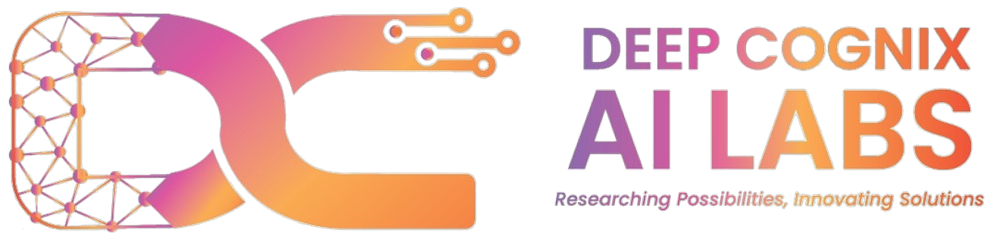
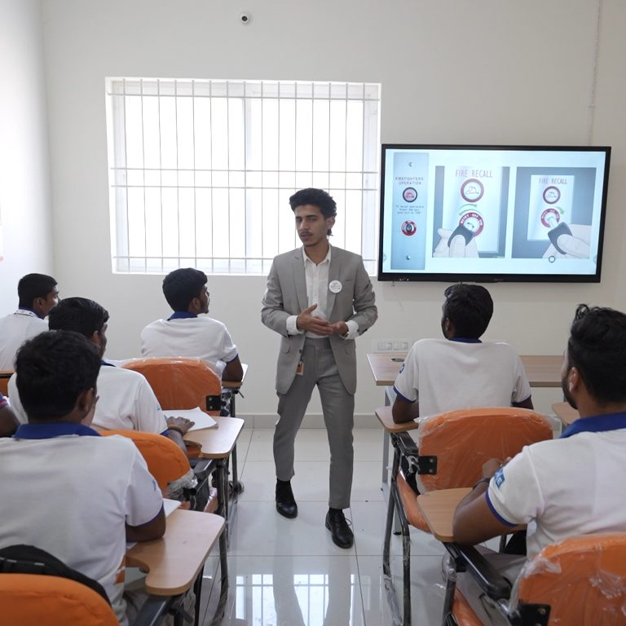

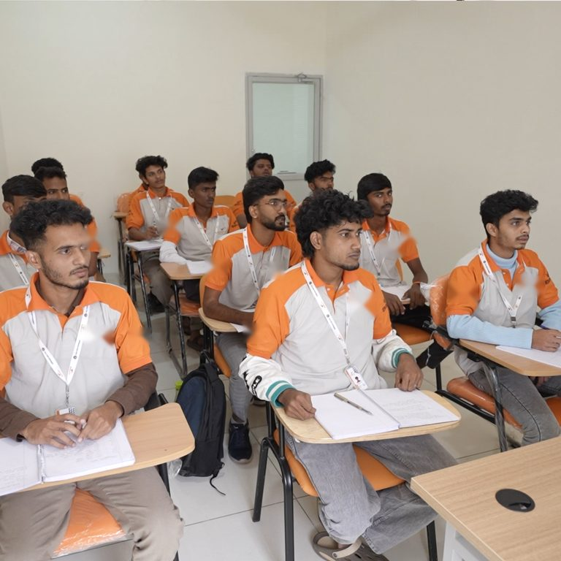
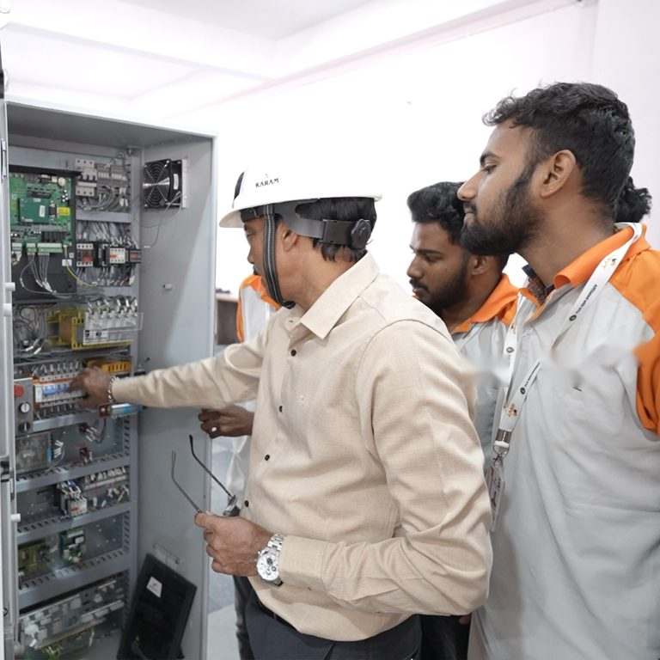
ABOUT US
DeepCognix AI Labs
DeepCognix AI Labs runs a focused, job-guaranteed skilling programme for the Vertical Transportation (VT) industry — the elevators, escalators, moving walkways and multilevel parking systems that keep modern India moving.
We take ITI, Diploma and Degree holders, put them through one intensive month of theory and hands-on practical training in Bengaluru, and deploy them with elevator and escalator companies across Tier 1 and Tier 2 cities, PAN India.
1
Our mission
Turn technically qualified young people into employable VT technicians in 30 days.
2
Our promise
Every candidate who completes the programme is deployed with a VT company.
3
Our approach
Industry-designed syllabus, real equipment, and trainers from the VT field.
Classroom and practical sessions at our Bengaluru training centre
DeepCognix AI Labs | Bengaluru | info@deepcognix.com
2

Slide 3

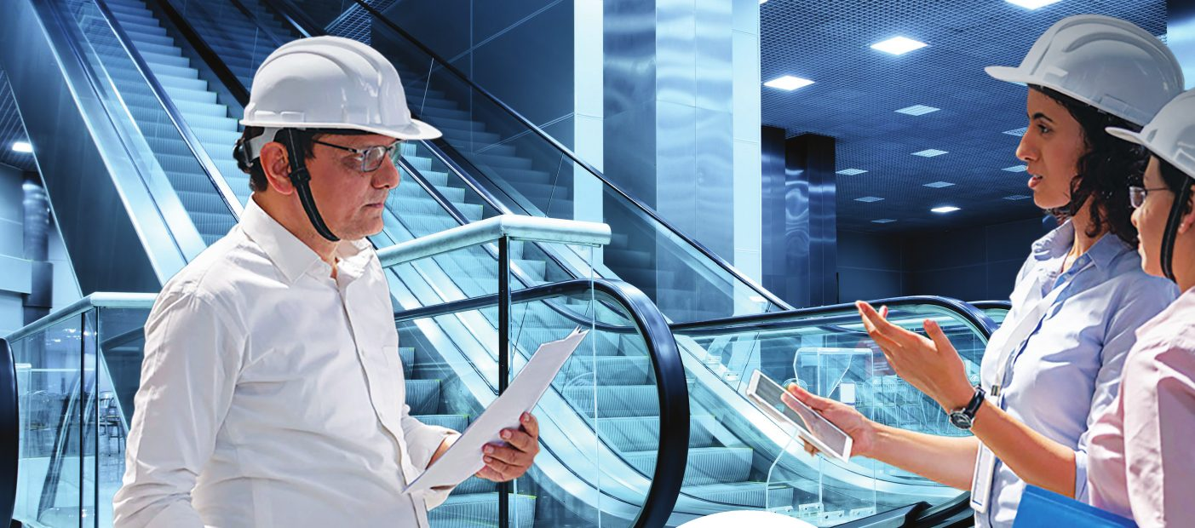
THE OPPORTUNITY
An industry short of skilled hands
Every new mall, metro station, hospital, airport and high-rise apartment needs elevators and escalators — and every one of them needs trained technicians to install, test and maintain it. The industry simply cannot find enough skilled hands.
USD 120 Bn+
1,00,000+
PAN INDIA
Global vertical transportation industry, growing steadily year on year
New jobs expected to be created globally in the VT sector by 2028
Placement across Tier 1 and Tier 2 cities — wherever buildings are rising
DeepCognix AI Labs | Bengaluru | info@deepcognix.com
3

Slide 4
WHY THIS INDUSTRY
A sector with room to grow — and to grow in
1
2
3
High demand, limited supply
A pipeline that keeps filling
Strong salary growth
The number of trained VT technicians in India is far below what the industry needs.
New towers, metros and airports mean a steady stream of fresh installations.
Earnings climb quickly with experience, in India and in overseas markets.
4
5
6
Fast-track progression
High job stability
Global mobility
Technician to Manager is a well-worn path — and it does not take a degree.
Every installed lift needs lifetime servicing, so the work does not dry up.
VT skills are portable — Indian technicians are recruited worldwide.
Where the industry is heading
Rapid urbanisation
Smart elevator technology
Safety innovations
Energy-efficient systems
More high-rises, malls, metros and hospitals every year.
IoT monitoring, destination control and predictive maintenance.
Tighter codes, better rescue systems and stricter inspection regimes.
Regenerative drives and gearless machines replacing older equipment.
DeepCognix AI Labs | Bengaluru | info@deepcognix.com
4

Slide 5
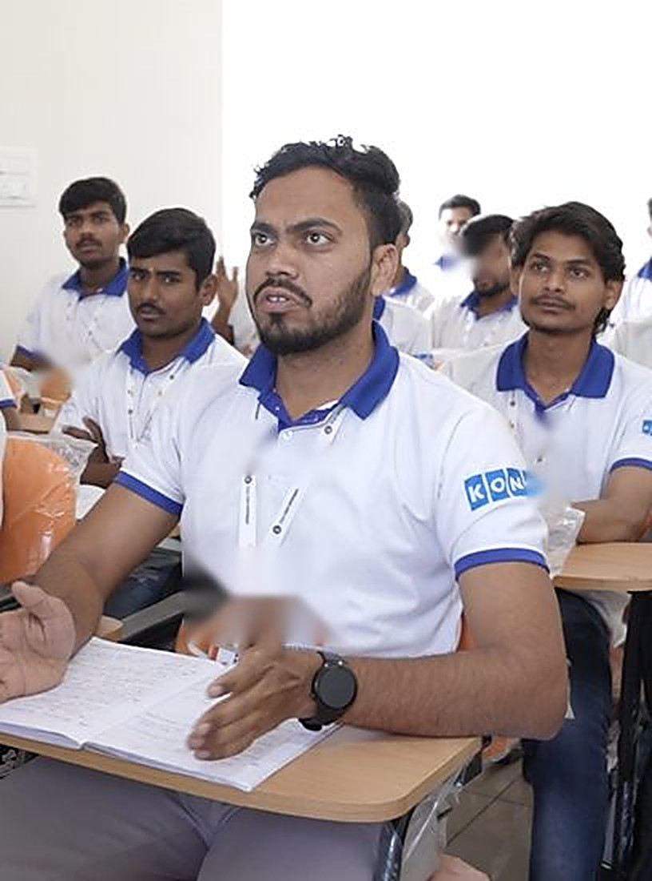
THE PROGRAMME
One month. One outcome. A job.
1
2
3
4
30 DAYS
BENGALURU
ITI & ABOVE
GUARANTEED
DURATION
LOCATION
ELIGIBILITY
PLACEMENT
Intensive full-time training — theory plus hands-on practical on live equipment.
Purpose-built training centre at Peenya Industrial Area, Bengaluru.
ITI, Diploma and Degree holders in Mechanical, Electrical, Electronics and allied trades.
Deployment with a VT company across Tier 1 and Tier 2 cities, PAN India.
Training schedule
Morning session: 9:00 AM to 1:00 PM
Afternoon session: 2:00 PM to 6:00 PM
Minimum 85% attendance required to qualify for deployment
Internal assessments through the month and a final evaluation
Small batches so every trainee gets time on the equipment
No prior elevator experience needed — we train you from the ground up.
DeepCognix AI Labs | Bengaluru | info@deepcognix.com
5

Slide 6

PROGRAMME HIGHLIGHTS
What you get
1
2
3
4
VT training
Job deployment
Pan-India placement
Hands-on lab training
Sponsored by our partner companies. You invest your time, not your money.
Deployed with a vertical transportation company from the second month onward.
Opportunities in metropolitan and Tier 2 cities right across the country.
Machines, controllers, rails and door assemblies you actually work on.
Certified under Skill India
Skill India is a Government of India initiative for training the Indian workforce with industry-relevant skills. On completing the programme you receive a course completion certificate recognised under it — a credential employers right across the country understand.
DeepCognix AI Labs | Bengaluru | info@deepcognix.com
6

Slide 7
ELIGIBILITY
Who can apply
You qualify if you are
An ITI holder — Electrical, Mechanical, Fitter, Turner, Electronics or an allied trade
A Diploma or Degree holder in an engineering discipline
An existing vertical transportation professional looking to formalise your skills
Aged between 18 and 30 years
What you also need
Documents to carry
Physically fit and comfortable working at heights
Basic reading of English or Hindi instructions
Willingness to be deployed at project sites across India
ITI / Diploma / Degree certificate and marks cards
Aadhaar card and two passport-size photographs
10th standard marks card
Bank account details and a copy of your resume
Fresh pass-outs and candidates who qualified years ago are both welcome.
DeepCognix AI Labs | Bengaluru | info@deepcognix.com
7

Slide 8
CURRICULUM · PART 1
Classroom theory that builds the foundation
1
Mechanical aspects of elevators
2
Electrical aspects of elevators
Types of elevators — traction, hydraulic, MRL
Cars, counterweights, guide rails and buffers
Gear and gearless machines
Shaft structure, pit design and maintenance
Basics of electricity and control systems
Control panels and logic circuits
Automatic Rescue Devices (ARD) and UPS
Door sensors, switches, relays and wiring
Motor control and inverter drive systems
3
Safety in vertical transportation
4
Soft skills for the workplace
Correct use of Personal Protective Equipment
Emergency procedures, safety circuits and alarms
Pit safety, shaft protection, top-of-car work
Rescue operations and inspection protocols
Communication with clients and team
Work ethics and site behaviour
Report writing and documentation
Interview preparation and job readiness
DeepCognix AI Labs | Bengaluru | info@deepcognix.com
8

Slide 9
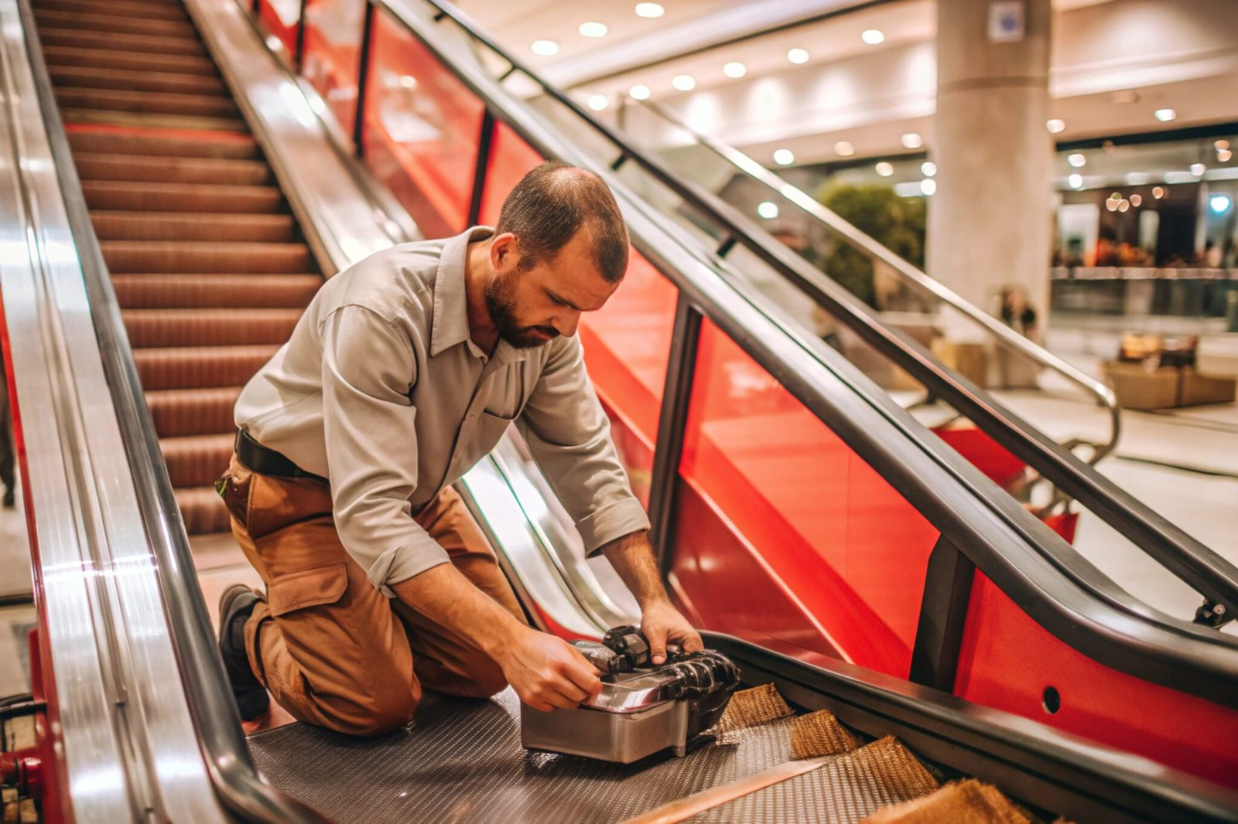
CURRICULUM · PART 2
Hands-on practical training on real equipment
1
Template installation
Reading technical drawings, recording measurements accurately, and crafting installation templates from wood or metal.
2
Guide rail installation
Guide rails, brackets and clips; installing and aligning rails in the shaft to DBG standards; checking for twist and misalignment.
3
Car frame and body
Components of the car frame and body, installation sequence, and getting alignment right the first time.
4
Landing and car doors
Door components and how they function; installing and aligning car doors and landing doors, mechanical and electrical.
5
Testing and commissioning
Reading electrical drawings; overhead equipment, machines, controller and rescue panels, ARD, governor, hoistway equipment and doors, car interior and bottom, operations.
Every trainee works on the equipment, not just watches it.
DeepCognix AI Labs | Bengaluru | info@deepcognix.com
9

Slide 10
TRAINING CENTRE
Where you will train
Our Bengaluru centre pairs classroom teaching with a working practical lab — machines, controllers, door assemblies and shaft mock-ups that mirror what you will find on a live site.
Practical lab
Smart classrooms
Small batches
Peenya location
Real machines, controllers and door assemblies to work on.
Projector-led sessions with drawings, diagrams and worked examples.
Enough trainer attention for every candidate to get hands-on time.
In the heart of Bengaluru's industrial belt, easy to reach.
DeepCognix AI Labs | Bengaluru | info@deepcognix.com
10

Slide 11
OUR COMMITMENT
The job guarantee, in plain words
Complete the 30-day programme, meet the attendance and assessment requirement, and DeepCognix AI Labs will deploy you with a vertical transportation company. That is the deal.
1
2
3
4
5
Enrol
Train
Assess
Certify
Get deployed
Register with your ITI, Diploma or Degree certificate and documents.
One month of theory and hands-on practical in Bengaluru.
Internal assessments through the month and a final evaluation.
Receive your Skill India recognised course completion certificate.
Join a VT company in a Tier 1 or Tier 2 city, PAN India.
Beyond deployment
Career guidance
Overseas pathway
Job referrals and placement support continue after you join your first company.
Skill enhancement inputs and guidance as you move up in the VT industry.
After six months of field experience you become eligible for international roles.
DeepCognix AI Labs | Bengaluru | info@deepcognix.com
11

Slide 12
HOW THE PROGRAMME WORKS
A direct path to employment
This is a job-oriented training programme, not a classroom course you leave with a piece of paper. Because our partner companies sponsor the training, the arrangement runs both ways — here is exactly what each side commits to.
Month 1
From month 2
Months 2 – 7
Intensive training at DeepCognix
Partner company deployment
Six-month work commitment
Industry-focused technical and practical training in Bengaluru to prepare you for deployment. Attendance and assessments count.
You are deployed to a vertical transportation company as an Associate Technician, earning while you gain field experience.
A minimum six-month commitment with the company that deployed you — this is what makes the sponsored training possible.
What you commit
What we commit
Attend the full 30 days and clear the assessments
Accept deployment at the assigned site or city
Stay a minimum of six months with the company
Full training at minimum course fee to you
A Skill India recognised completion certificate
A confirmed deployment with a VT company
DeepCognix AI Labs | Bengaluru | info@deepcognix.com
12

Slide 13
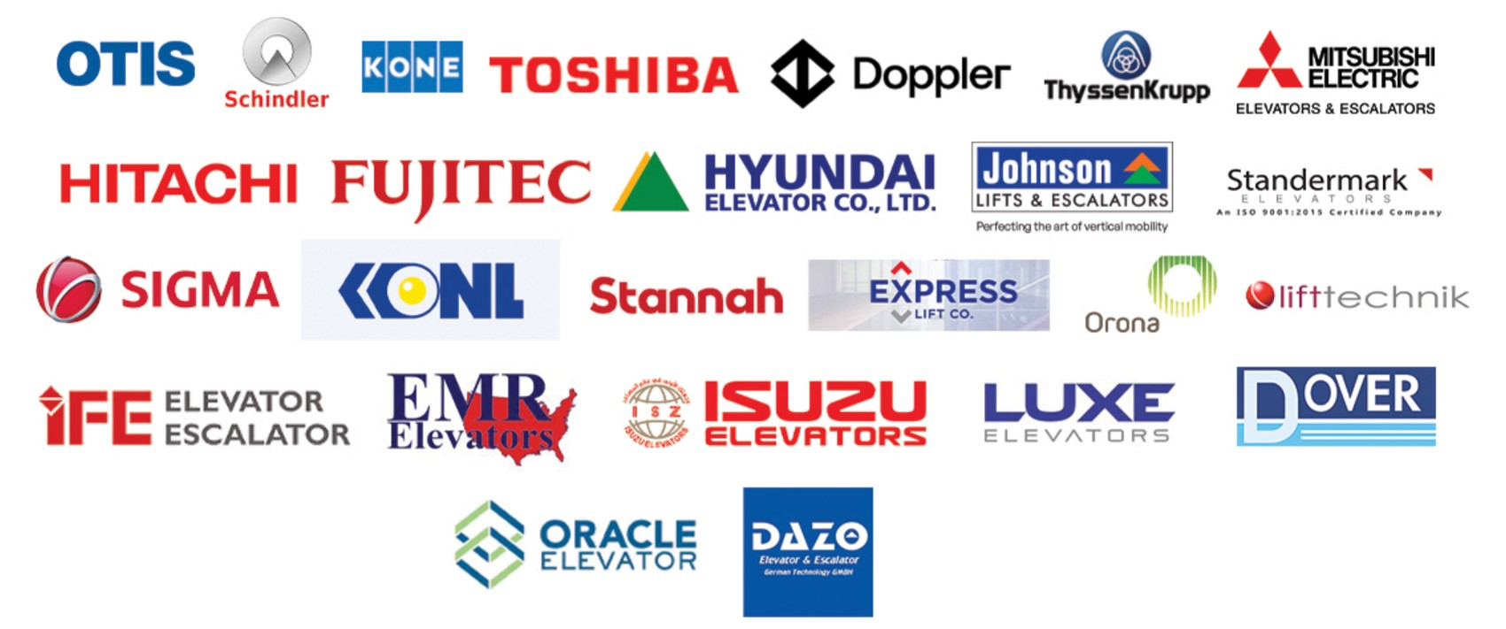
WHERE OUR CANDIDATES WORK
Companies hiring VT technicians
The vertical transportation industry in India is served by global majors and fast-growing national players alike. These are the kinds of companies our trained candidates are deployed with, across Tier 1 and Tier 2 cities.
Company names and logos are shown to indicate the industry landscape our trainees are deployed into. All trademarks belong to their respective owners.
DeepCognix AI Labs | Bengaluru | info@deepcognix.com
13

Slide 14
YOUR CAREER
Where this career can take you
You join the industry as an Associate Technician. What follows is the standard progression in vertical transportation — indicative CTC ranges for each rung, based on prevailing industry levels.
1
Associate Technician
₹2L – ₹5L CTC
Assisting senior technicians in elevator and escalator installation and maintenance.
2
Technician
₹5L – ₹9L CTC
Independently performs installation, servicing and troubleshooting of elevators and escalators.
3
Senior Technician
₹10L – ₹15L CTC
Leads site-level technical work and handles complex maintenance and troubleshooting.
4
Supervisor
₹15L – ₹18L CTC
Manages teams, oversees site operations and ensures service quality and timelines.
5
Project Engineer
₹19L – ₹25L CTC
Plans and executes projects, coordinating resources, timelines and technical requirements.
6
Project Manager
₹25L – ₹30L+ CTC
Oversees multiple projects, managing budgets, teams and overall project delivery.
Indicative industry CTC ranges. Actual compensation varies by company, city, experience and performance.
DeepCognix AI Labs | Bengaluru | info@deepcognix.com
14

Slide 15
GLOBAL CAREER OPPORTUNITY
The world hires Indian VT technicians
After completing your six-month work commitment and gaining field experience as an Associate Technician, you become eligible for overseas placement opportunities with leading global companies.
Middle East
Europe
United Kingdom
Other markets
UAE, Qatar, Saudi Arabia, Kuwait and Bahrain
Spain, France, Germany, Greece, Poland, Netherlands and Portugal
One of the largest markets for experienced lift technicians
Serbia, New Zealand and other growing destinations
₹50,000+
Company-sponsored benefits may include
Flight ticket to the destination country
Visa charges and documentation support
Accommodation arranged by the employer
Starting monthly salary on overseas placements. Varies by country and employer.
Overseas opportunities depend on employer demand, visa rules and individual performance. Benefits vary by company and are not guaranteed.
DeepCognix AI Labs | Bengaluru | info@deepcognix.com
15

Slide 16
WHY US
Why DeepCognix AI Labs
1
Job guaranteed
2
Just 30 days
The programme exists to get you employed. Deployment is the outcome we are measured on.
No year-long course, no long wait. One month from enrolment to job-ready.
3
Basic course fee
4
Skill India certified
Training is sponsored by our partner companies — you invest your time, not your money.
A course completion certificate recognised under the Government of India's Skill India initiative.
5
Hands-on, not theory-only
6
A career, not just a job
You will handle machines, controllers, rails and doors, not just read about them.
A clear ladder from Associate Technician to Project Manager, and a route overseas.
Thirty days that change what you can earn for the rest of your working life.
DeepCognix AI Labs | Bengaluru | info@deepcognix.com
16

Slide 17
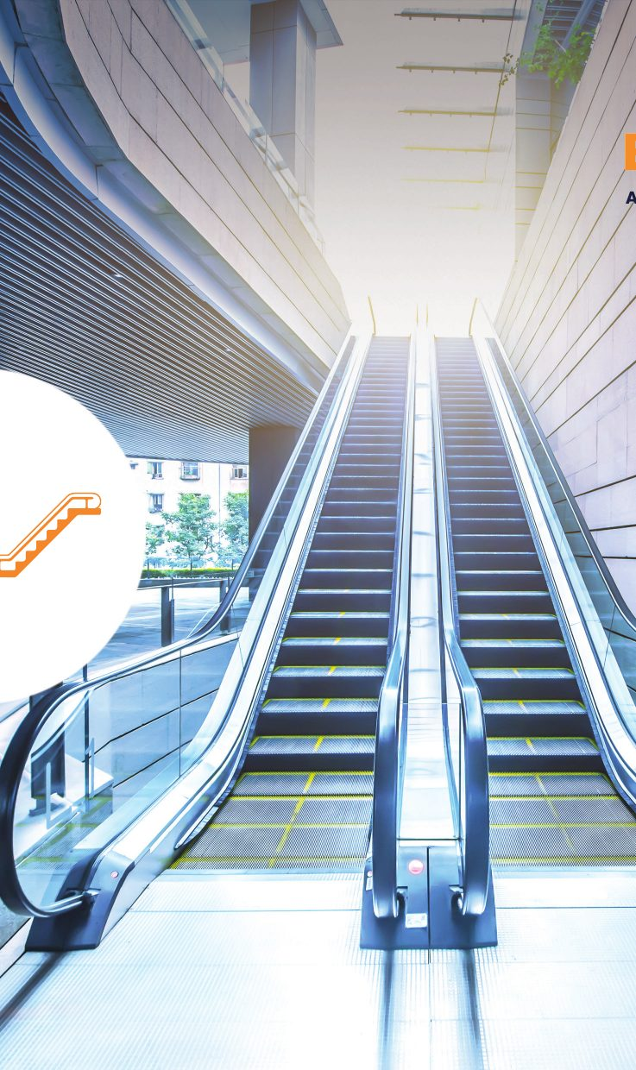
GETTING STARTED
How to join
1
Call or WhatsApp us
Reach Amrit Bose on +91 99866 97969 or Sumit Gupta on +91 97395 85515 to check the next batch date.
2
Share your details
Send your name, qualification and trade, year of completion and preferred work location to info@deepcognix.com.
3
Document verification
Bring your certificates, marks cards, Aadhaar and photographs to the Peenya centre.
Skill India certified
Certificate recognised under the Government of India's Skill India initiative
4
Confirm your seat
Seats per batch are limited so that every candidate gets practical time on the equipment.
Talk to us
Amrit Bose +91 99866 97969
Sumit Gupta +91 97395 85515
info@deepcognix.com
5
Start training
Report to the Bengaluru centre on your batch start date and begin the 30-day programme.
DeepCognix AI Labs | Bengaluru | info@deepcognix.com
17

Slide 18
Your ticket to a career in Vertical Transportation
Thirty days of training in Bengaluru. A Skill India recognised certificate. A guaranteed deployment with a vertical transportation company — and a career that can take you across India and overseas.
Amrit Bose
Sumit Gupta
Email us
+91 99866 97969
+91 97395 85515
info@deepcognix.com
TRAINING CENTRE
1st Floor, T-4/A, 2nd Cross Road, Peenya 1st Stage,
Peenya II Phase, Peenya, Bengaluru, Karnataka 560058
Limited seats — call today
DeepCognix AI Labs · Researching Possibilities, Innovating Solutions

